Slide 2
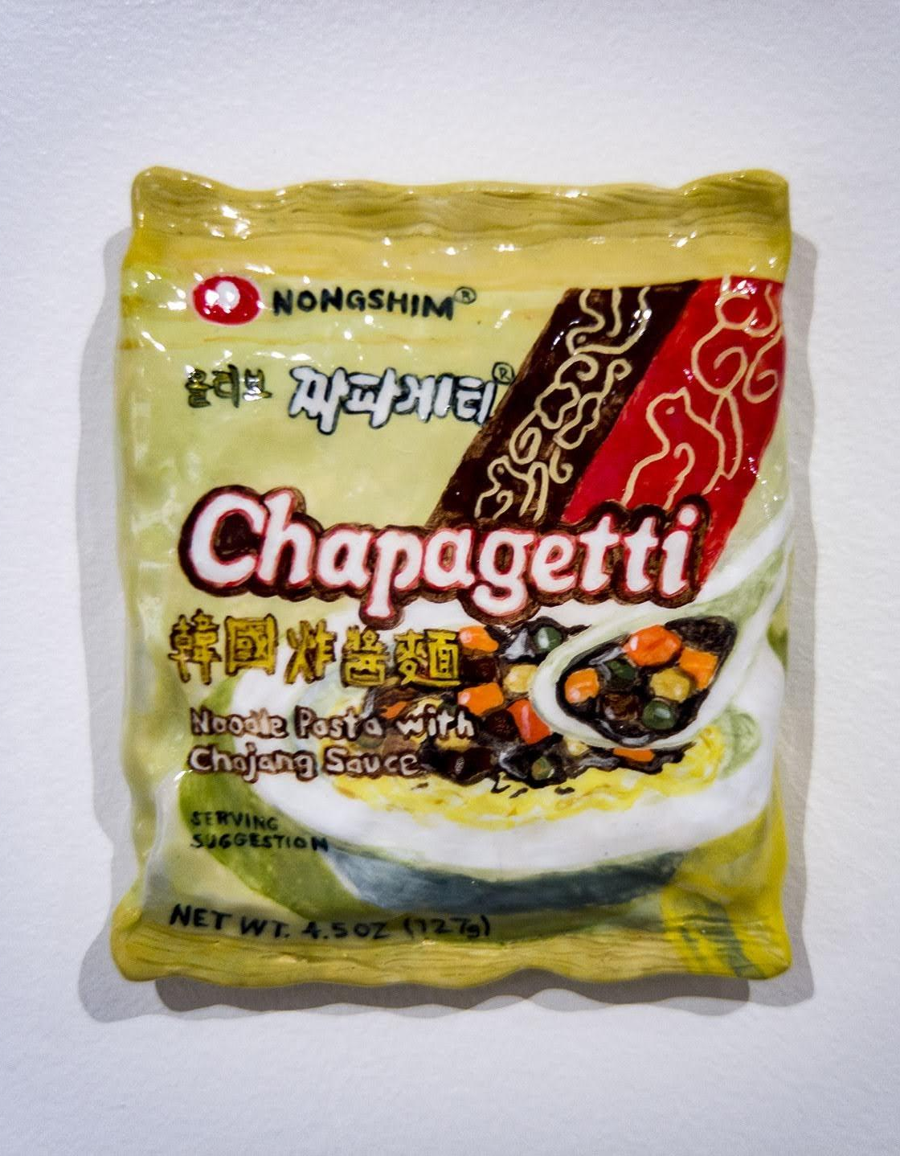
Why does food matter?
Food is something that people interact with every day. It provides energy, and the building blocks for our body. Every culture in the world has their own ways of cooking food, and their own traditions associated with eating that food.
Why does art matter?
The art matters because it helps us see the world the way other people see it. Art helps us understand people who have different traditions and ways of thinking then we are used to.
Don’t these pictures look like real food?
All of the works you will be seeing in this virtual tour were created by artists out of clay. China has a long history of clay, and by working in this material artists are pulling from their cultural history.
Stephanie H. Shih
Nongshim Chapagetti, 2019, Ceramic,
7 x 6 x 1 inches

Slide 3
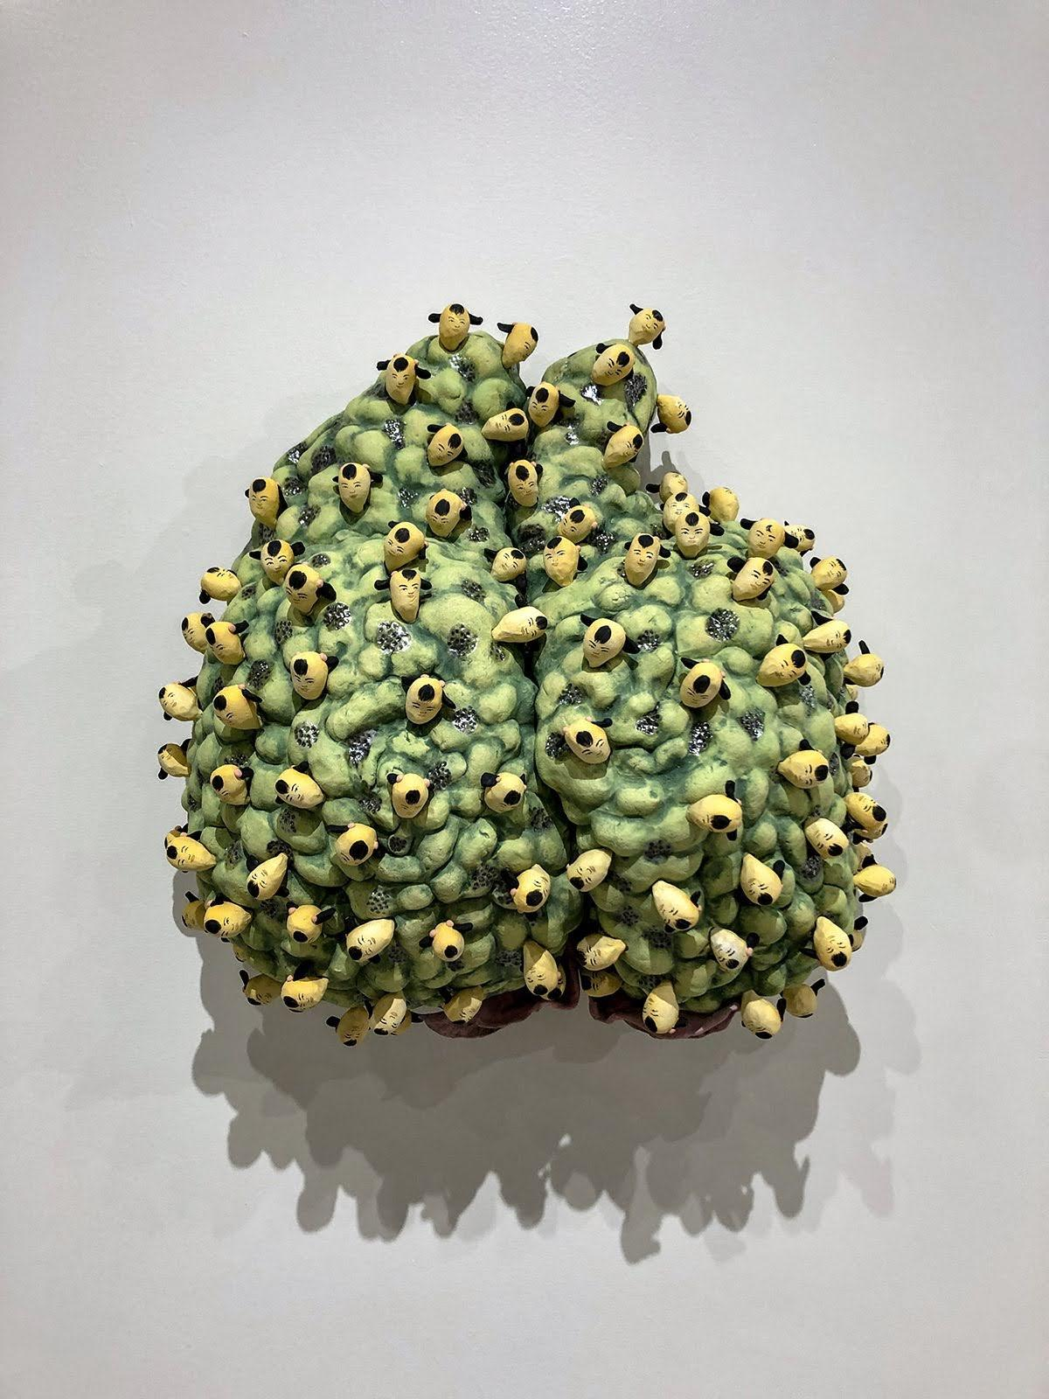
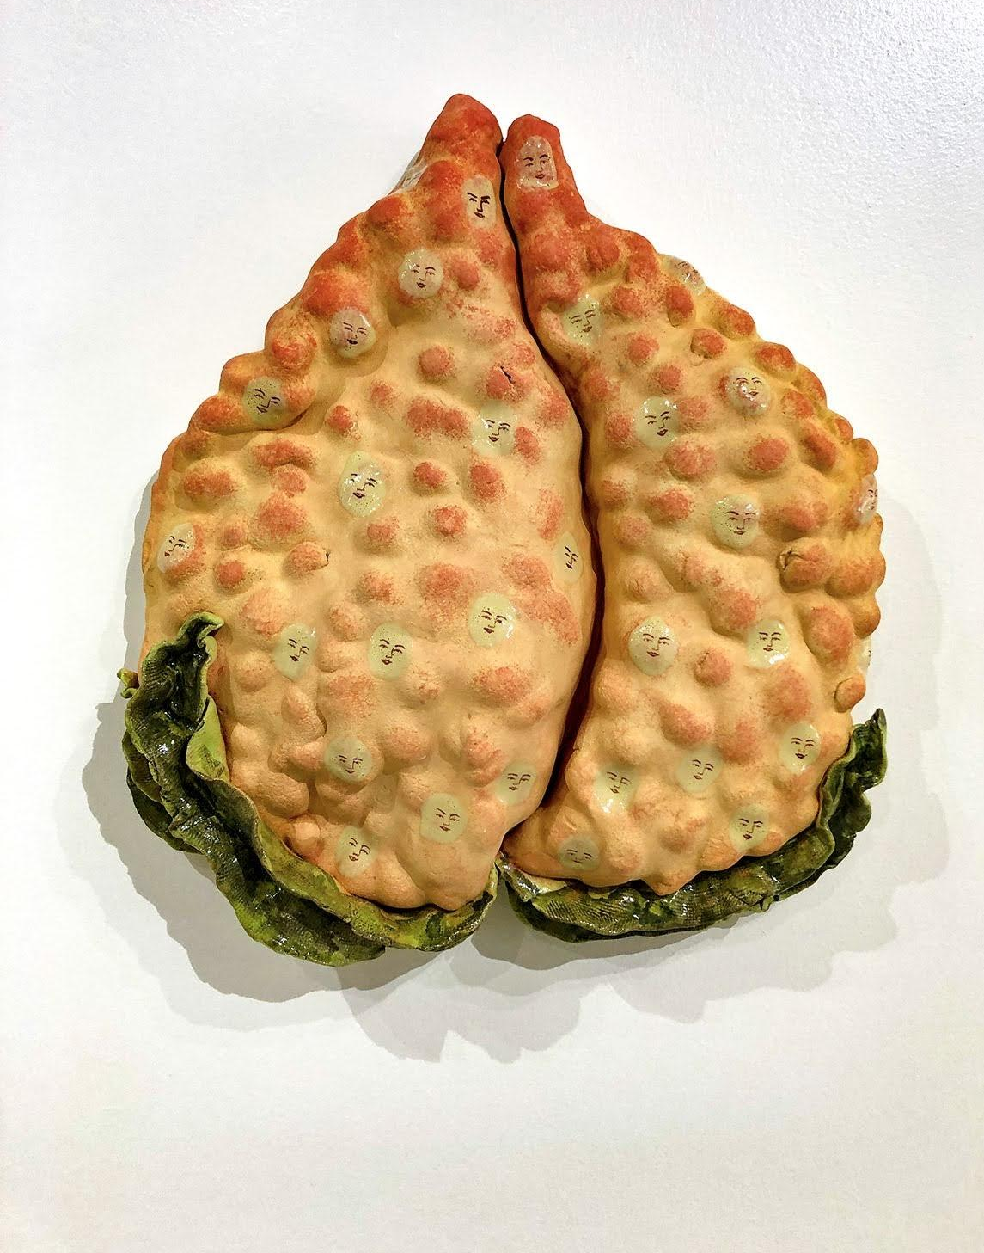
Cathy Lu’s work explores the idea that food can be a language of home, and investigates the way food creates a sense of identity and belonging.
Compare and contrast the two works you see on the left.
Why do you think the colors are so different between the two peaches?
What do you think Lu is trying to convey in this body of work?
(Above) Cathy Lu, Peach with Heads, 2018. Ceramic with underglaze and luster.
(Right) Cathy Lu, Peach with Faces from the Afterlife, 2018. Ceramic with underglaze and luster.

Slide 4
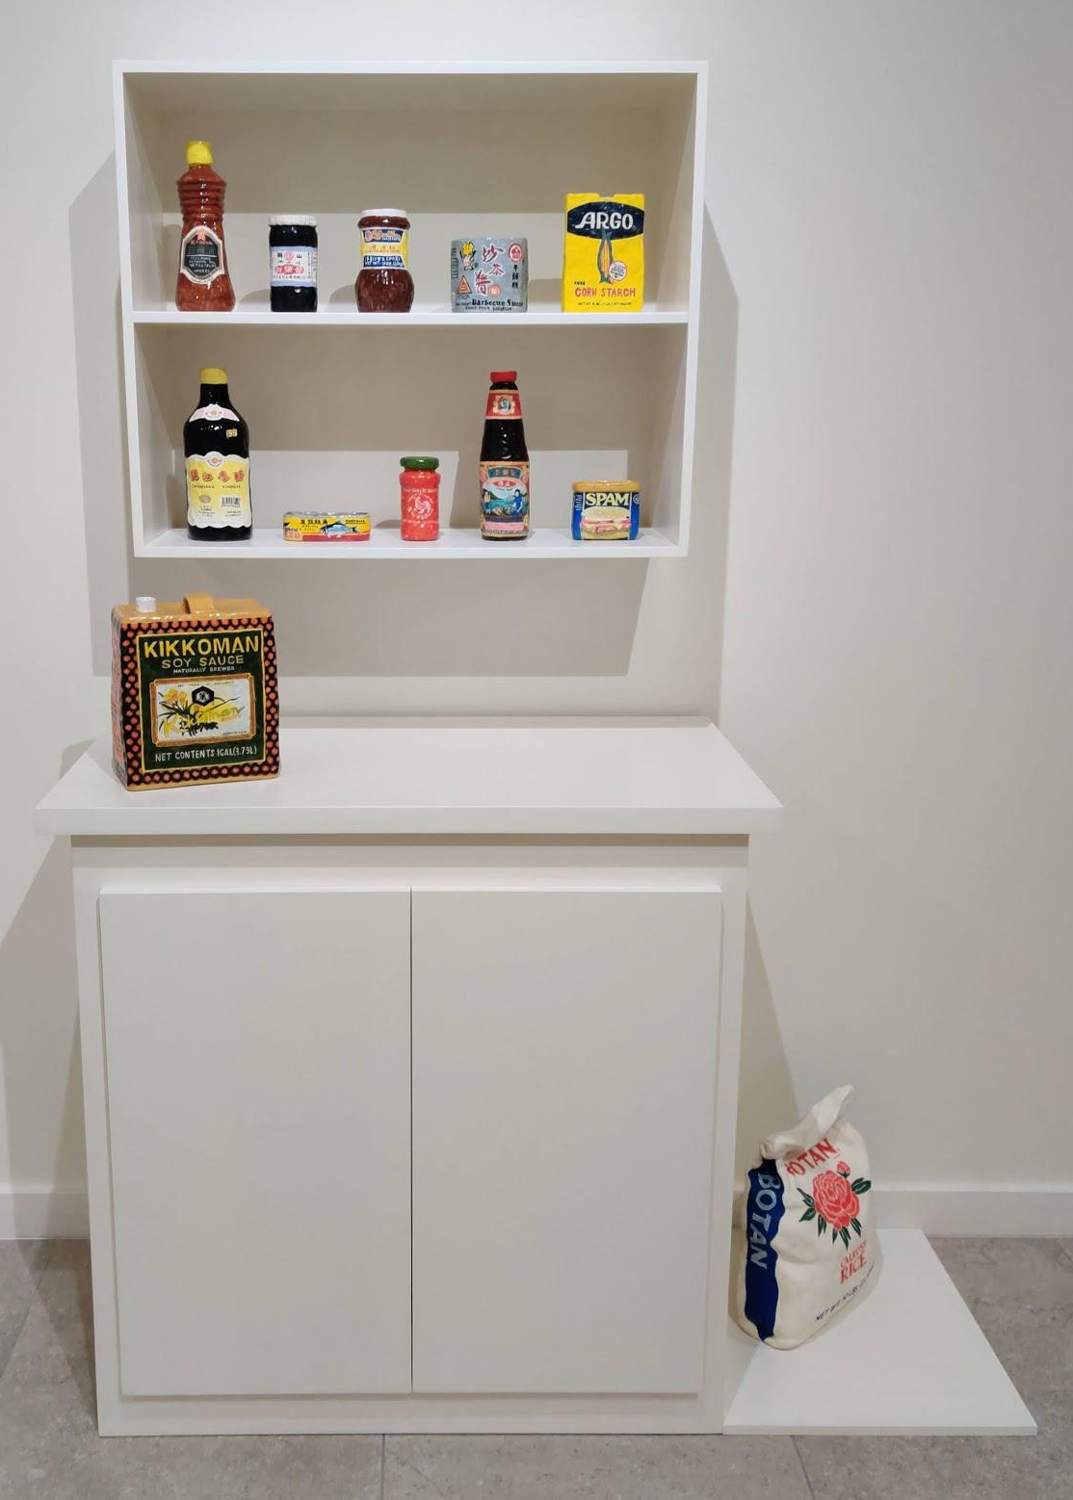
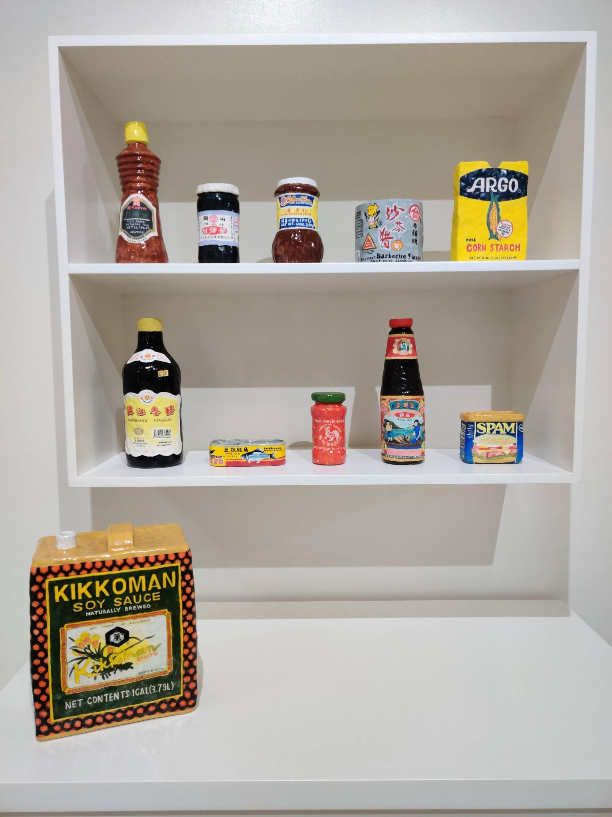
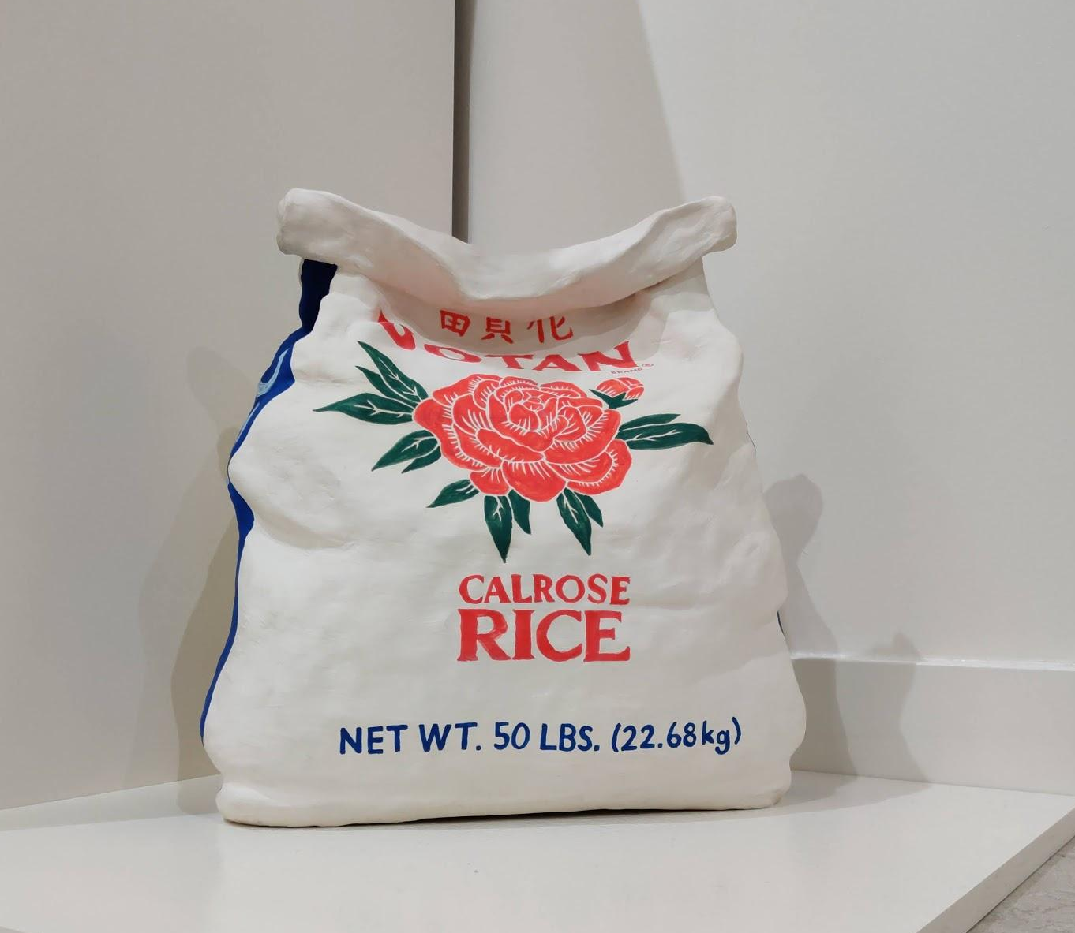
“Food carries meaning for everyone but especially people who have only known life in the diaspora, whose identities are tied to a figurative homeland that exists only in the memories and experiences that this set of people have had.“
Stephanie H. Shih
Diaspora means: the scattering of any people from their original homeland.
Why is it important that this work is in a pantry instead of on a pedestal?
Why do you think Shih chose to make the foods she made?
Stephanie H. Shih
Pantry, 2018, Ceramic,
54 x 22 x 76 inches

Slide 5
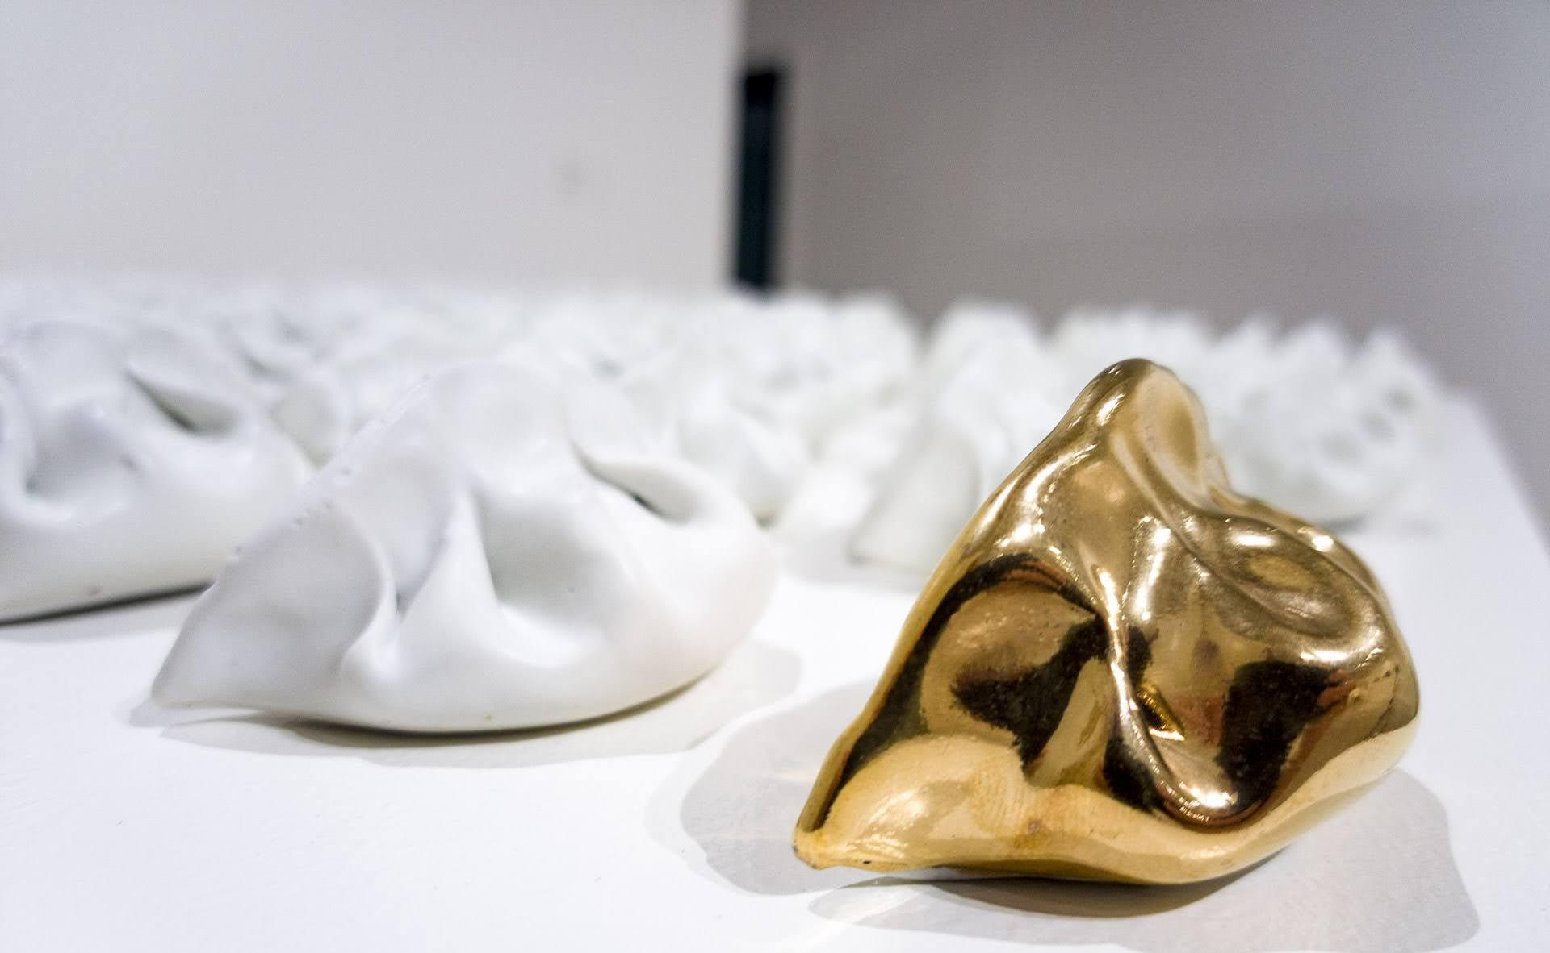
What do you think of when you think of gold?
What does it mean to be the golden child?
Why do you think Shih titled this work, “Golden Child”?
Stephanie H. Shih, Golden Child, 2020. Porcelain, glaze, and luster.

Slide 6
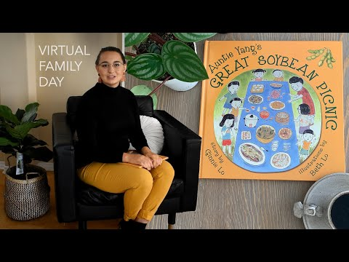
Take a moment to watch this reading of “Auntie Yang’s Great Soybean Picnic,” (written by Ginnie Lo and Illustrated by Beth Lo) , and answer the discussion questions on the next page.

Slide 7
Discussion Questions
1. Why was discovering soybeans in Illinois so important to Auntie Yang?
2. Why do you think so many families wanted to take part in Auntie Yang’s Annual
soybean picnic?
3. What is your favorite food your family makes? Why?
4. Does your family have any traditions that include food? How did those traditions
get started?
5. How does Auntie Yang’s Great Soybean Picnic relate to the art we looked at earlier
in this virtual tour?

Slide 8
Exhibition Acknowledgments
The following individuals and organizations are acknowledged, with gratitude, for making this exhibition possible.
Anonymous
DEW Foundation
Jason Lau
Los Angeles County Department of Arts and Culture
Pasadena Art Alliance
Ralph M. Parsons Foundation
Ruth & Joseph C. Reed Foundation for the Arts
Susan & John Sasaki

